Slide 1

Big Data Analysis with IBM Cloud Databases
BY
CHANDRAVEL .P
DHANUSH .P
DINESH .N
HABISHEK .R
HARISH KUMAR .P

Slide 2
Problem Statement
Dive into the world of big data analysis with IBM Cloud Databases. Uncover hidden insights from vast datasets, from climate trends to social patterns. Visualize your findings and derive valuable business intelligence. Embark on data-driven adventures, exploring the endless possibilities of big data!
The project involves delving into big data analysis using IBM Cloud Databases. The objective is to extract valuable insights from extensive datasets, ranging from climate trends to social patterns. The project includes designing the analysis process, setting up IBM Cloud Databases, performing data analysis, and visualizing the results for business intelligence.

Slide 3

Design Thinking
Data Selection
Identify the datasets to be analyzed, such as climate data or social media trends.

Slide 4
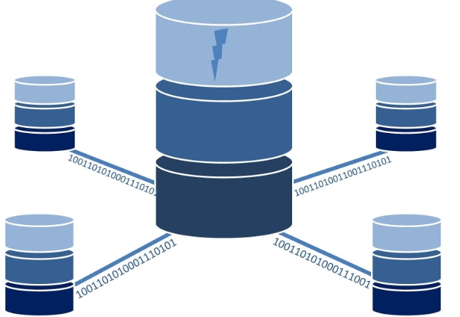
Design Thinking
Database Setup
Set up IBM Cloud Databases for storing and managing large datasets.

Slide 5

Design Thinking
Data Exploration
Develop queries and scripts to explore the datasets, extract relevant information, and identify patterns.

Slide 6

Design Thinking
Analysis Techniques
Apply appropriate analysis techniques, such as statistical analysis or machine learning, to uncover insights

Slide 7

Design Thinking
Visualization
Design visualizations to present the analysis results in an understandable and impactful manner.

Slide 8

Design Thinking
Business Insights
Interpret the analysis findings to derive valuable business intelligence and actionable recommendations.

Slide 9
THANK YOU

